Slide 1
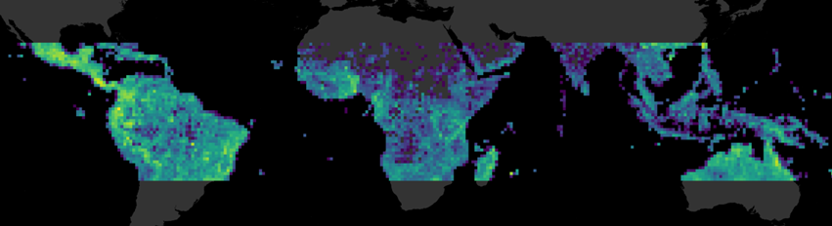



Big data biogeography and the evolution of tropical diversity
Alexander Zizka & Daniele Silvestro
http://alexanderzizka.net
https://github.com/azizka
@BiodivRsity

Slide 2

Goals of these talks and workshop
“We are drowning in information while starving for wisdom”
E. O. Wilson (1999) Consilience: The unity of knowledge

Slide 3
Goals of these talks and workshop

Slide 4
Outline
Biodiversity distribution: knowns and unknowns
(Evolutionary) Biogeography in practice

Slide 5
Outline
Biodiversity distribution: knowns and unknowns
(Evolutionary) Biogeography in practice

Slide 6
Biogeography
“The science that attempts to document and understand spatial patterns of biological diversity.”
Lomolino et al. (2006)

Slide 7
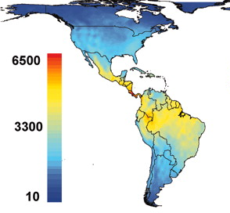
Understanding biodiversity
Processes
Patterns
Evolutionary biogeography
Speciation, extinction, migration
Species, genes, functions, bioregions
Silvestro et al (2011) BMC Evol Biol, Kreft & Jetz 2007, PNAS

Slide 8
Scale matters!
Antonelli et al (2018)

Slide 9
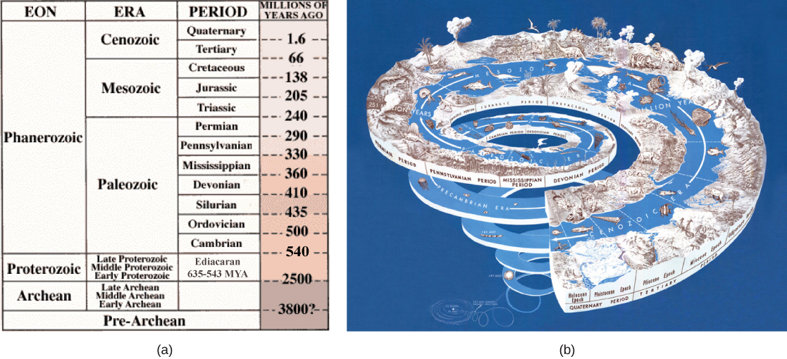
Biodiversity varies through time…

Slide 10
… and space
Barthlott et al. (2005)

Slide 11
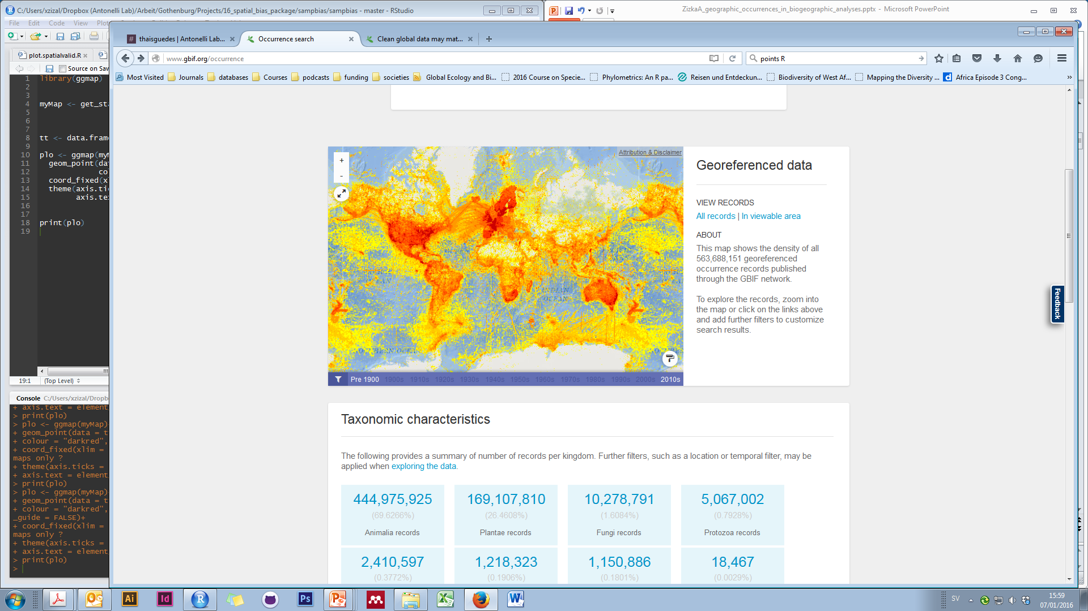
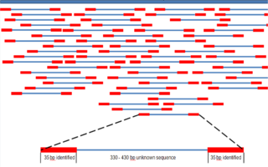
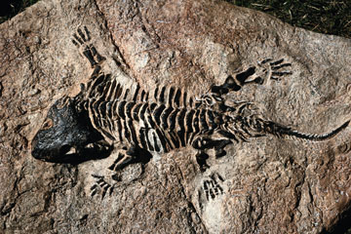
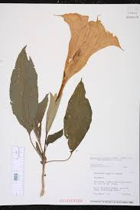
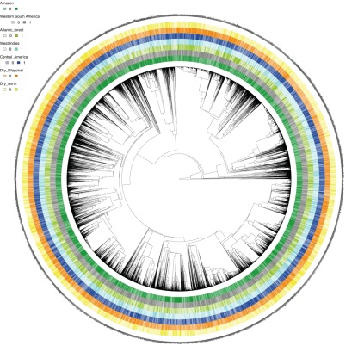
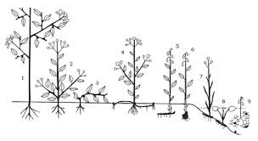
Main sources of biodiversity data
Distribution
DNA
Fossils
Traits
Taxonomy
Phylogenies

Slide 12
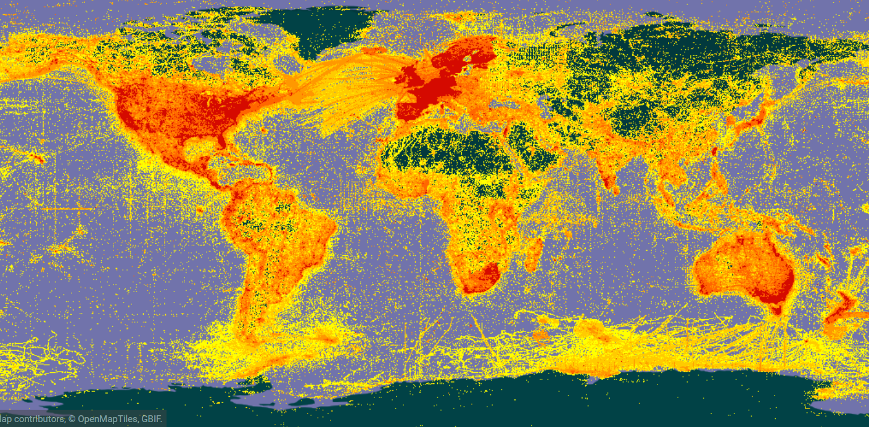

We have a lot of data…
Notes:
Who is familiar with GBIF

Slide 13
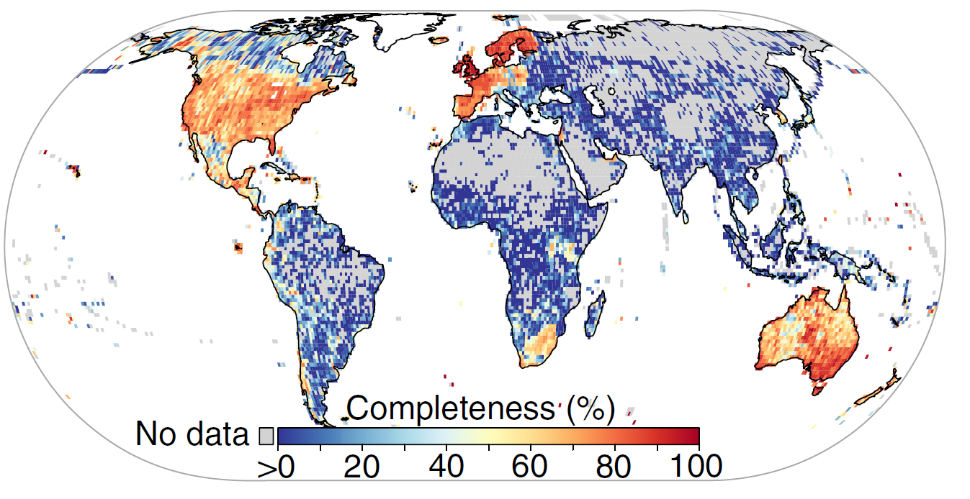
… but also lot of problems
Wallacean shortfall: “The geographic distribution of most species still poorly known.”
Meyer et al (2015) Nat. Comm.

Slide 14
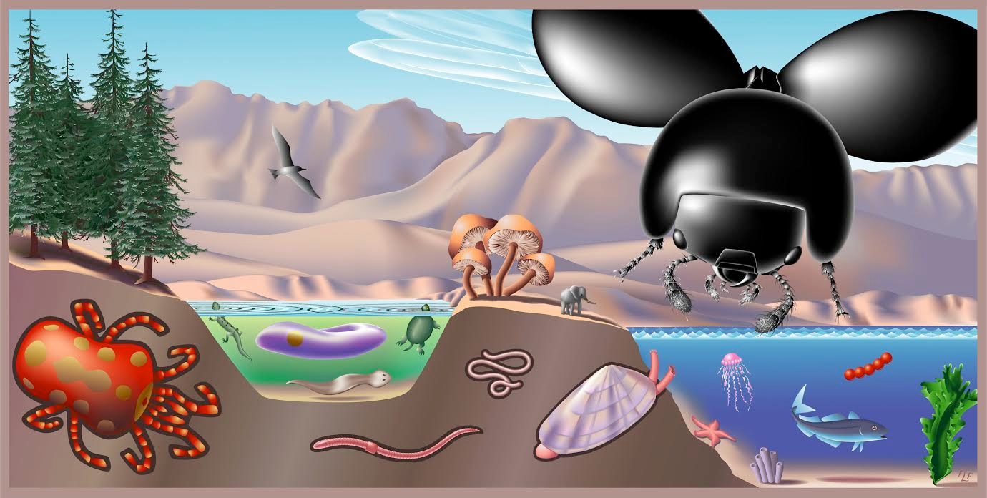
Key challenges:
Filling gaps
Dealing with biases and errors
“Species-scape”

Slide 15
Outline
Biodiversity distribution: knowns and unknowns
(Evolutionary) Biogeography in practice: Time and space

Slide 16
Outline
Biodiversity distribution: knowns and unknowns
(Evolutionary) Biogeography in practice: Time and space

Slide 17
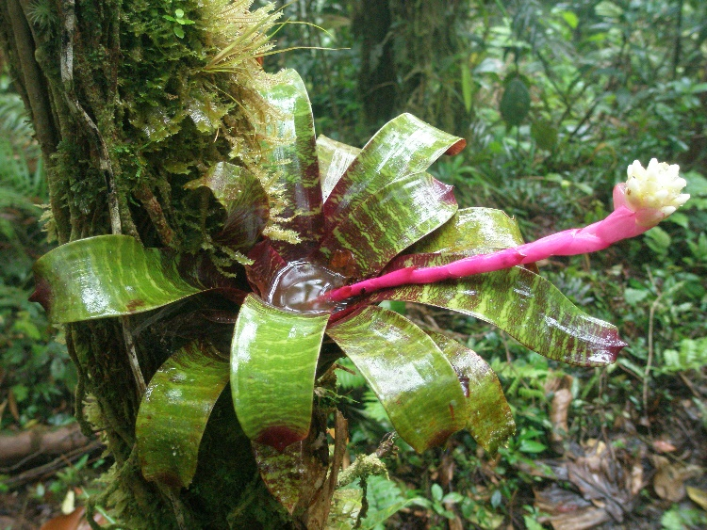
Space #I: Biodiversity patterns in the tropics
Species richness
Knowledge richness
The pineapple family (Bromeliaceae): A Neotropic radiation with c. 3,500 species

Slide 18
Space #I: Biodiversity patterns in the tropics
Scanned and cleaned > 780,000 occurrence records from databases and field collections for 16,582 taxa using CoordinateCleaner
Zizka et al. (in press), DDI

Slide 19
Space #I: Biodiversity patterns in the tropics
Species richness
Endemism
Threatened species
Zizka et al. (in press), DDI

Slide 20
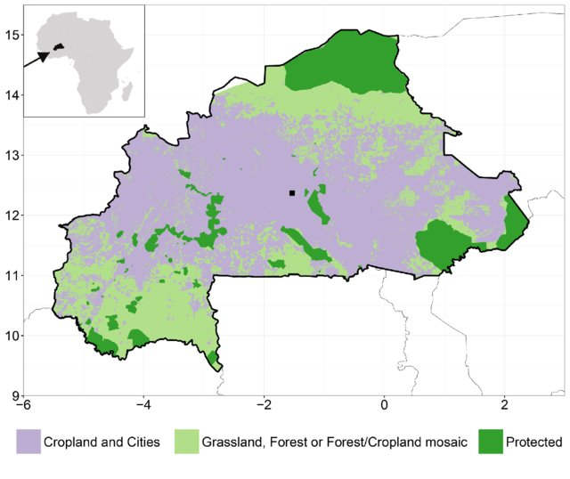

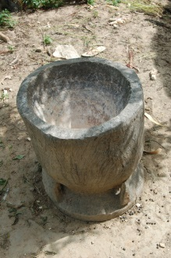
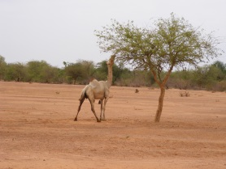
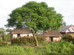
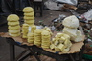
Space #I: Biodiversity patterns in the (sub)tropics
A complete Atlas of the flora of Burkina Faso

Slide 21
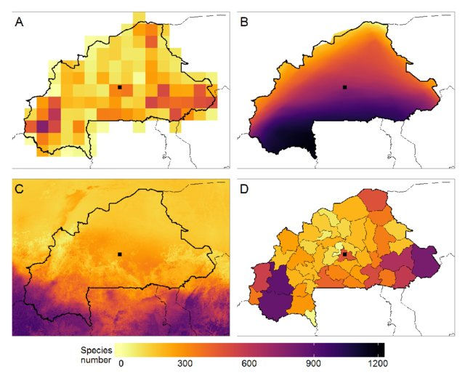
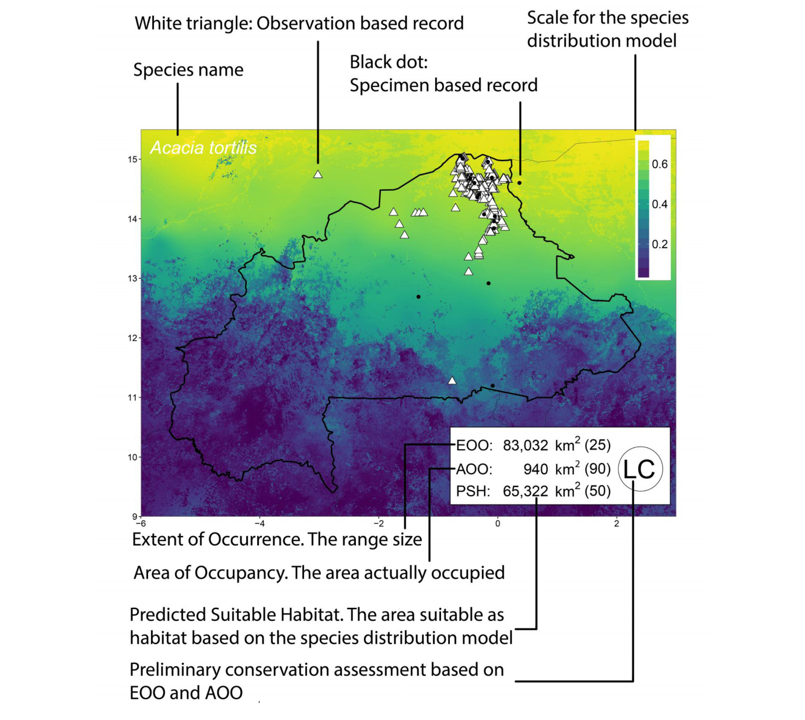
Space #I: Biodiversity patterns in the tropics
Schmidt et al. (2017), Phytotaxa

Slide 22
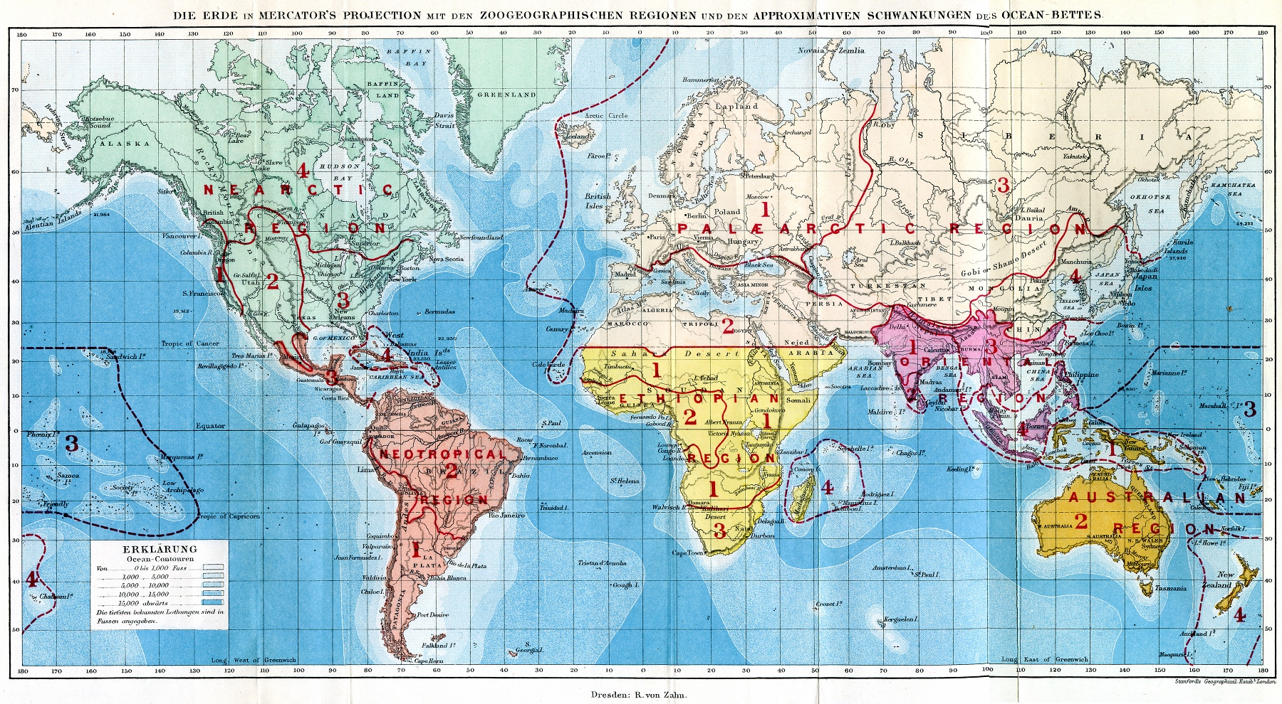
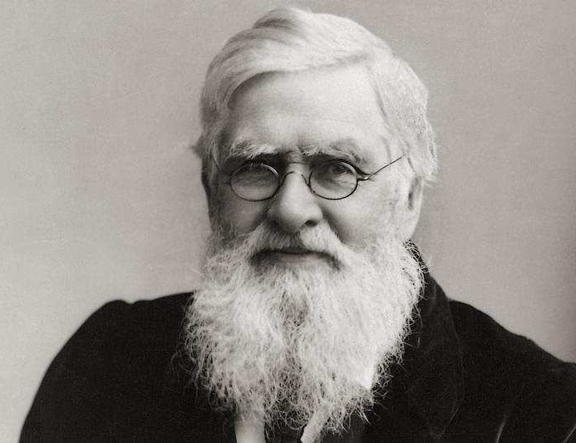
Space #2: Identifying and delimiting bioregions
Wallace (1876)

Slide 23
Space #2: Identifying and delimiting bioregions
Myers (2001), Antonelli (2009)

Slide 24
Space #2: Identifying and delimiting bioregions
By “expert opinion”
By similarity
Morrone (2014), Zootaxa

Slide 25
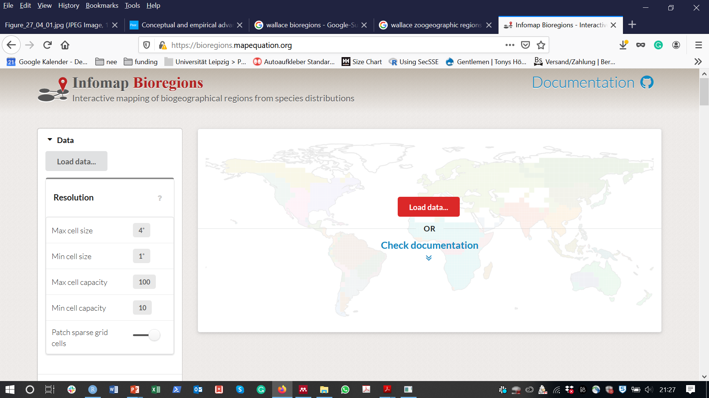

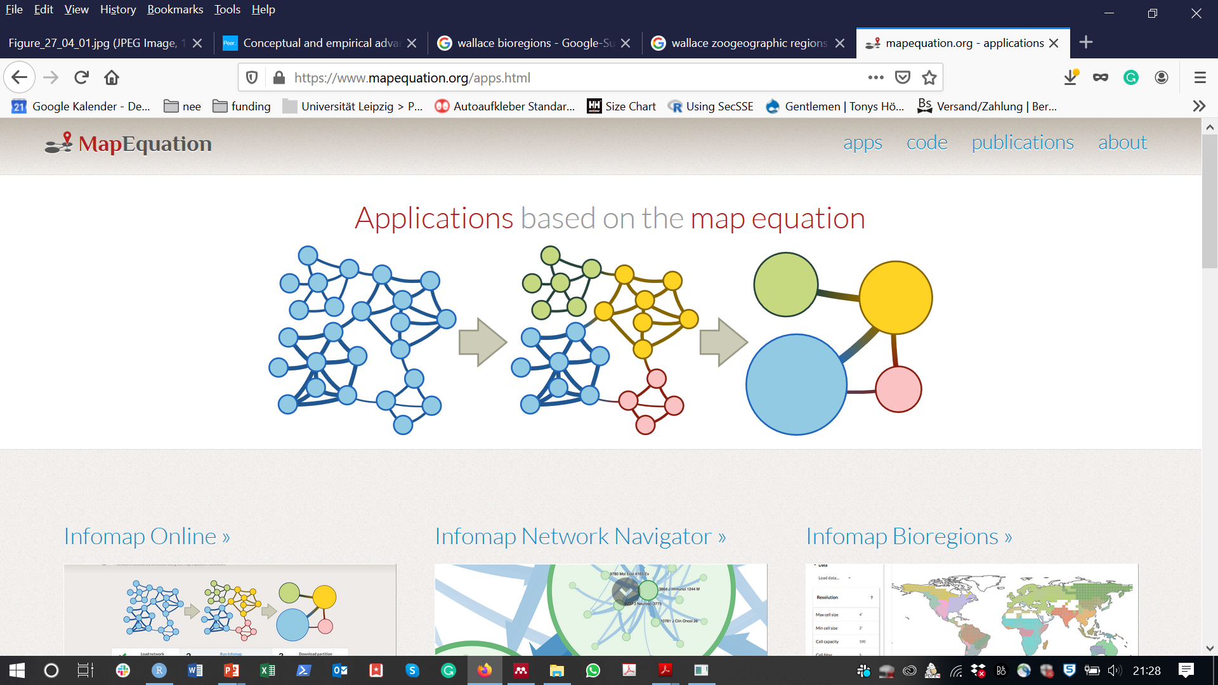
Space #2: Identifying and delimiting bioregions
Vilhena & Antonelli (2015) Nat Comm
Edler et al. (2017) Syst Biol
Zizka et al (2018) Ecography

Slide 26
Space #2: Identifying and delimiting bioregions
Antonelli (2017), Nat Eco Evol

Slide 27
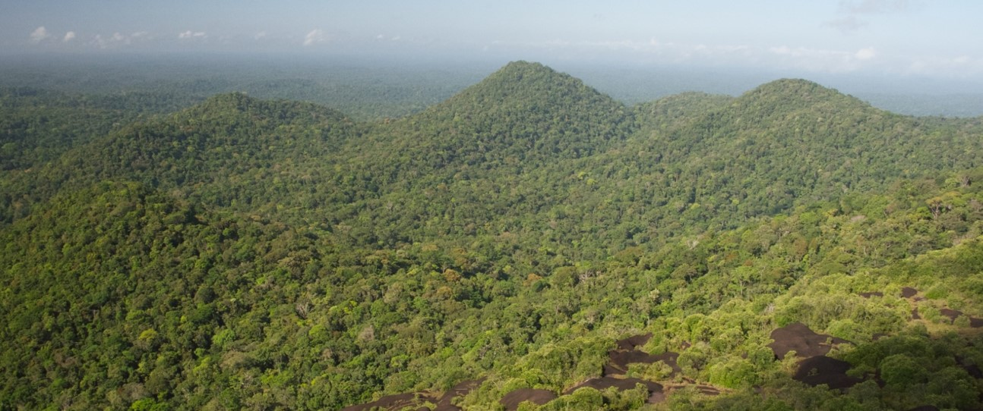
Space #3: The distribution of rare species

Slide 28
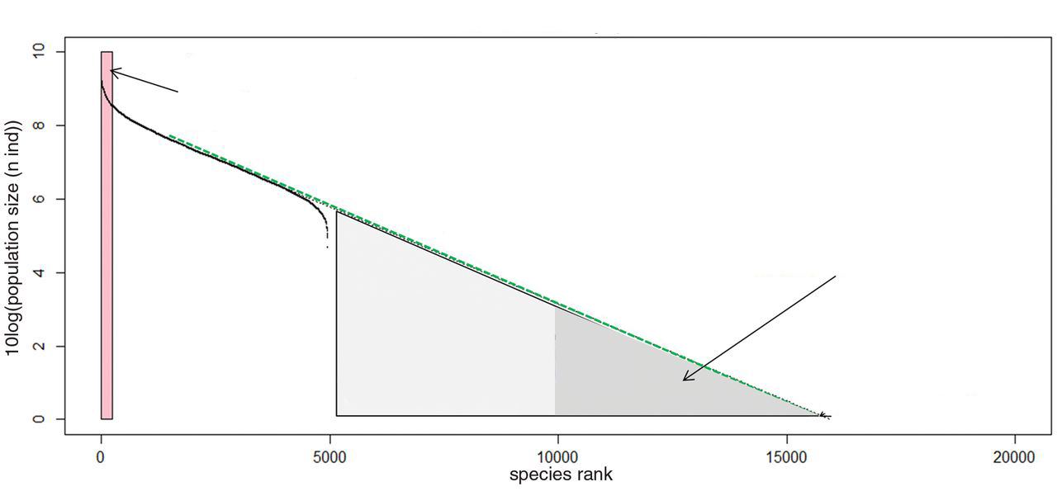
Space #3: The distribution of rare species
Most species within the Amazonian rainforest have small populations
10
Hyper dominants
8
6
Number of Individuals [log10]
Population < 1000 individuals
4
2
0
0
5000
10000
15000
20000
Species rank
Modified after ter Steege et al. (2013) Science
Notes:
Rare species are a puzzling element of biodiversity, because it is often unclear how they can avoid extinction and maintain gene flow, and because they are of special concern for conservation. Interestingly, it has recently been proposed, that many of the tree species in the Amazonian rainforest are actually rare. Here you can see an estimate of the population size of all Amazonian tree species (explain graph), which shows that there are about only 200 hyperdominant species with large population size representing the majority of individuals in Amazonia, whereas one third of the species comprises less than 1000 individuals. However, virtually nothing was known of the geographic distribution of these species.

Slide 29
Space #3: The distribution of rare species
Area: Amazonia
Data: 1.5 M occurrence records from 67,000 species
Record cleaning using CoordinateCleaner
Species Assignment using SpeciesGeoCoder
Zizka et al. (2018), Ecography

Slide 30
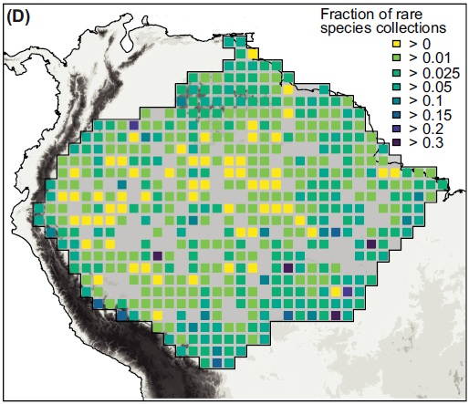
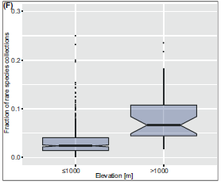
Space #3: The distribution of rare species
“Rare species” are more common in the highlands
Zizka et al. (2018), Ecography

Slide 31
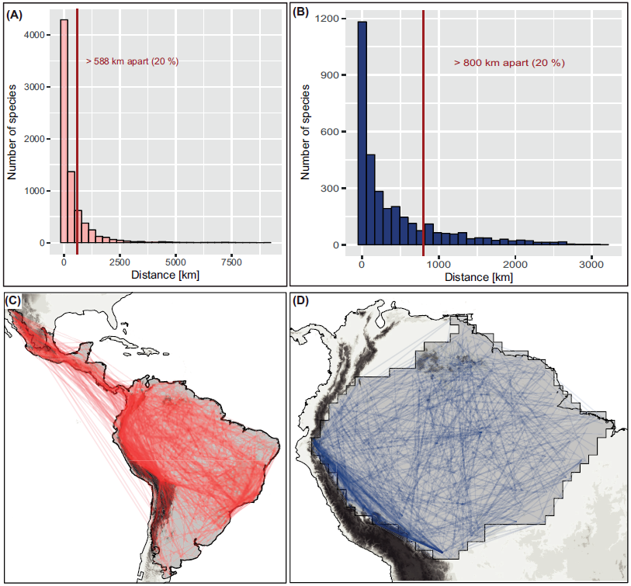
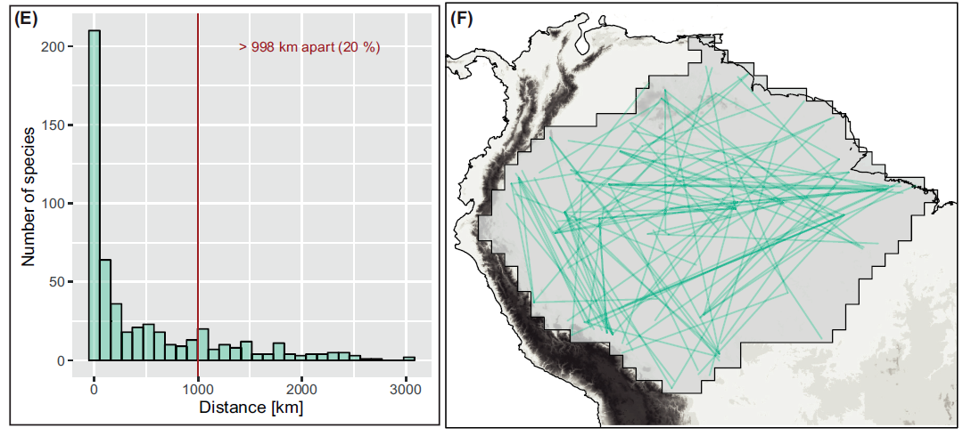
Space #3: The distribution of rare species
> 800 km apart (20%)
> 998 km apart (20%)
Zizka et al. (2018), Ecography

Slide 32
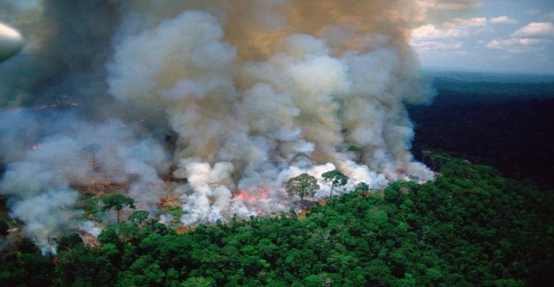
Space #4: Speeding up conservation assessments

Slide 33
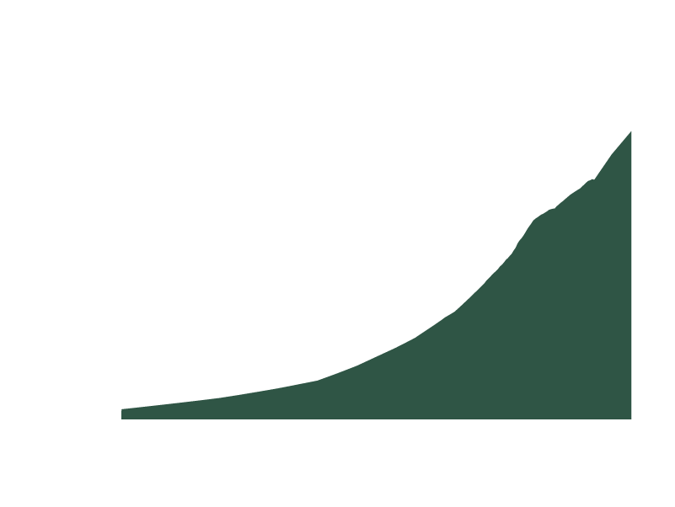
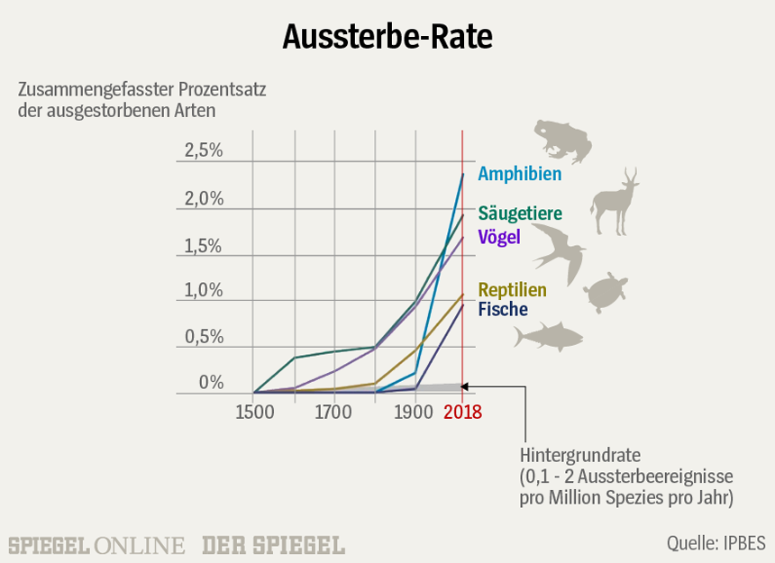
Space #4: Speeding up conservation assessments
WWF 2018, IPBES 2019

Slide 34

Space #4: Speeding up conservation assessments

Slide 35

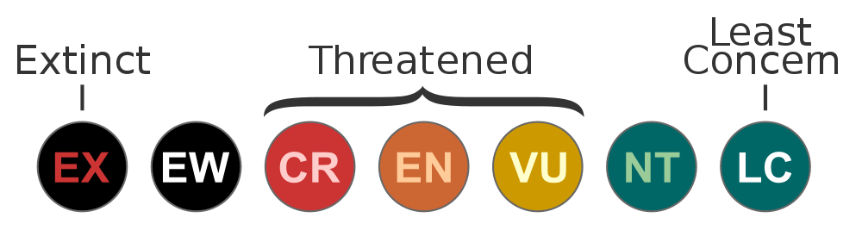
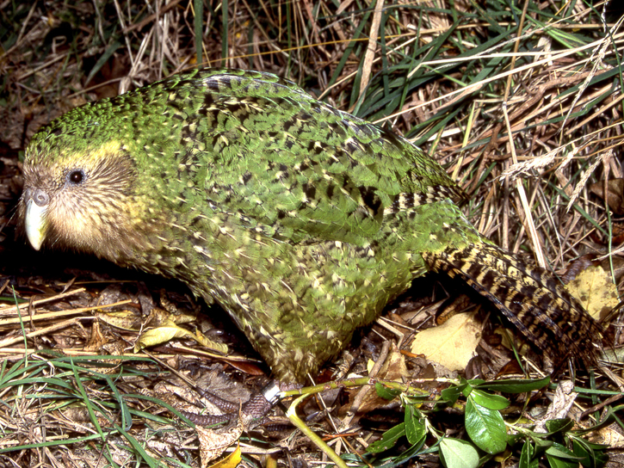
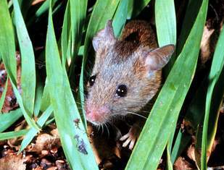
Space #4: Speeding up conservation assessments
Geographic range, Population size, Population trend, Threats

Slide 36
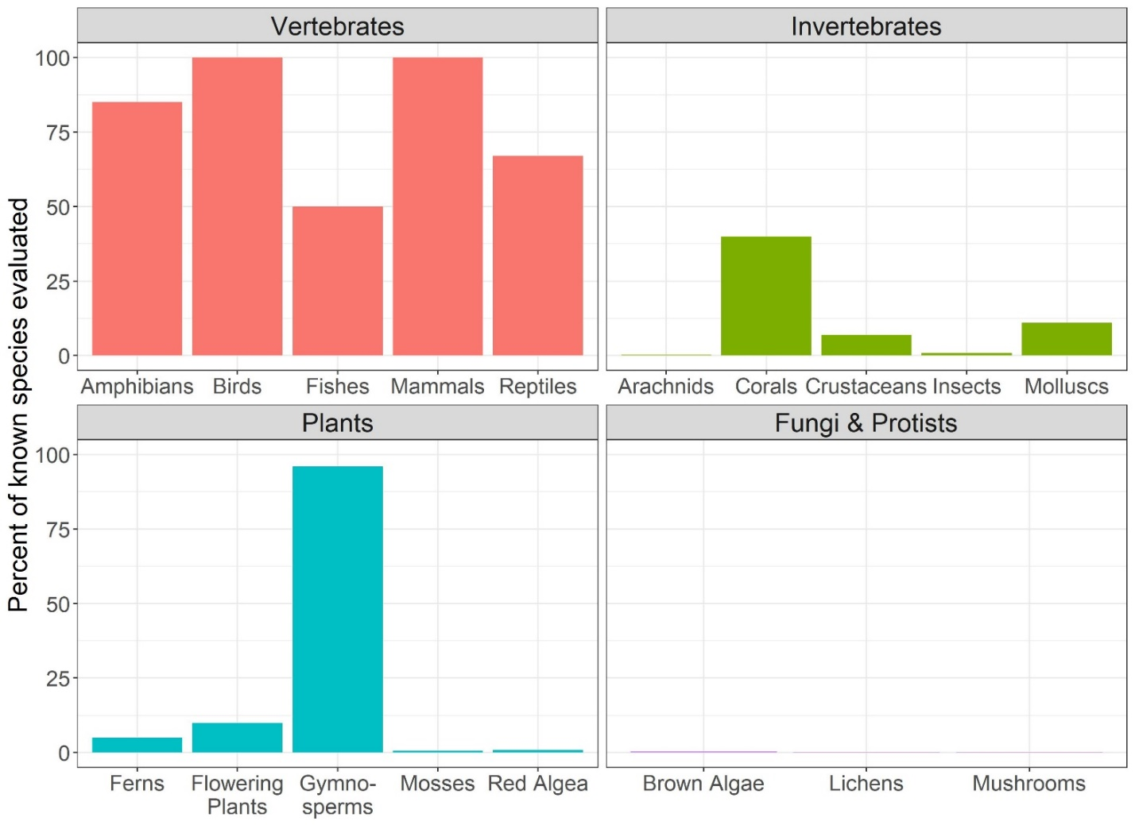
Space #4: Speeding up conservation assessments
High quality & high impact
Time & data intensive
Data from
www.iucnredlist.org
Notes:
Which are related to the evaluation process. Species are evaluated based on expert knowledge, informed by data (on the five indicator criteria). The first problem is, that due to the expert based process, the assessments are somewhat subjective and difficult to reproduce. And the second problem is that the process is very data intense, which leads to a severe taxonomic bias. That is exemplified by this graph that shows the percentage of species evaluated for red lists in different taxonomic groups. AS you can see all of birds and mammals and most of vertebrate species are evaluated, but few invertebrates and almost no microbes. Or
IUCN red lists are based on expert assessment
Mostly available for well studied groups and regions

Slide 37
Space #4: Speeding up conservation assessments
How to speed up conservation assessments?

Slide 38
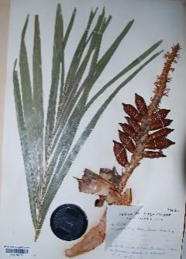
Space #4: Speeding up conservation assessments
GBIF > 1,300,000,000 records
Notes:
And because it is his 250th birthday this year, I say Humboldt to the rescue. And with him all the scientists that have been and are collecting scientific specimens for the last 300 years. Today, georeferenced occurrence data from more than 1.3 billion of these speciesmens are publicly available via the global biodiversity Information facility, and provide a fantastic resource on species geographic distribution.

Slide 39
Space #4: Speeding up conservation assessments
Approximation of IUCN assessment based on geographic range
Species with a small range and are considered more threatened
Quick, cheap, easy
Occurrence records
Extent of Occurrence (EOO)
Area of Occupancy (AOO)
But, how accurate?

Slide 40
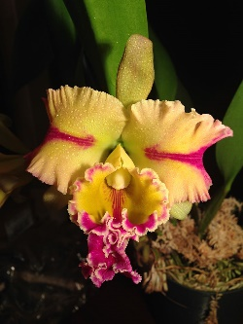
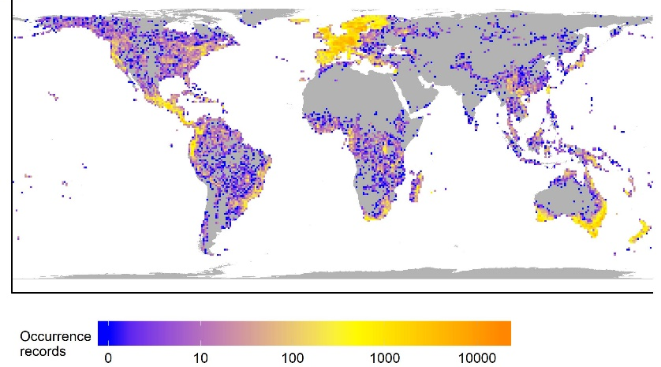
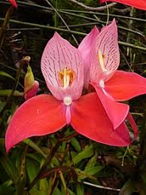
Space #4: Speeding up conservation assessments
AA for 14,177 orchid species (> 1 million of records)
Comparison with > 900 full IUCN assessments
Automated conservation assessment ConR

Slide 41
Space #4: Speeding up conservation assessments

Slide 42

Space #4: Speeding up conservation assessments
Correctly classified 76% of species as possibly threatened or not threatened
Zizka et al., in review

Slide 43
Space #4: Speeding up conservation assessments
Zizka et al., in review

Slide 44
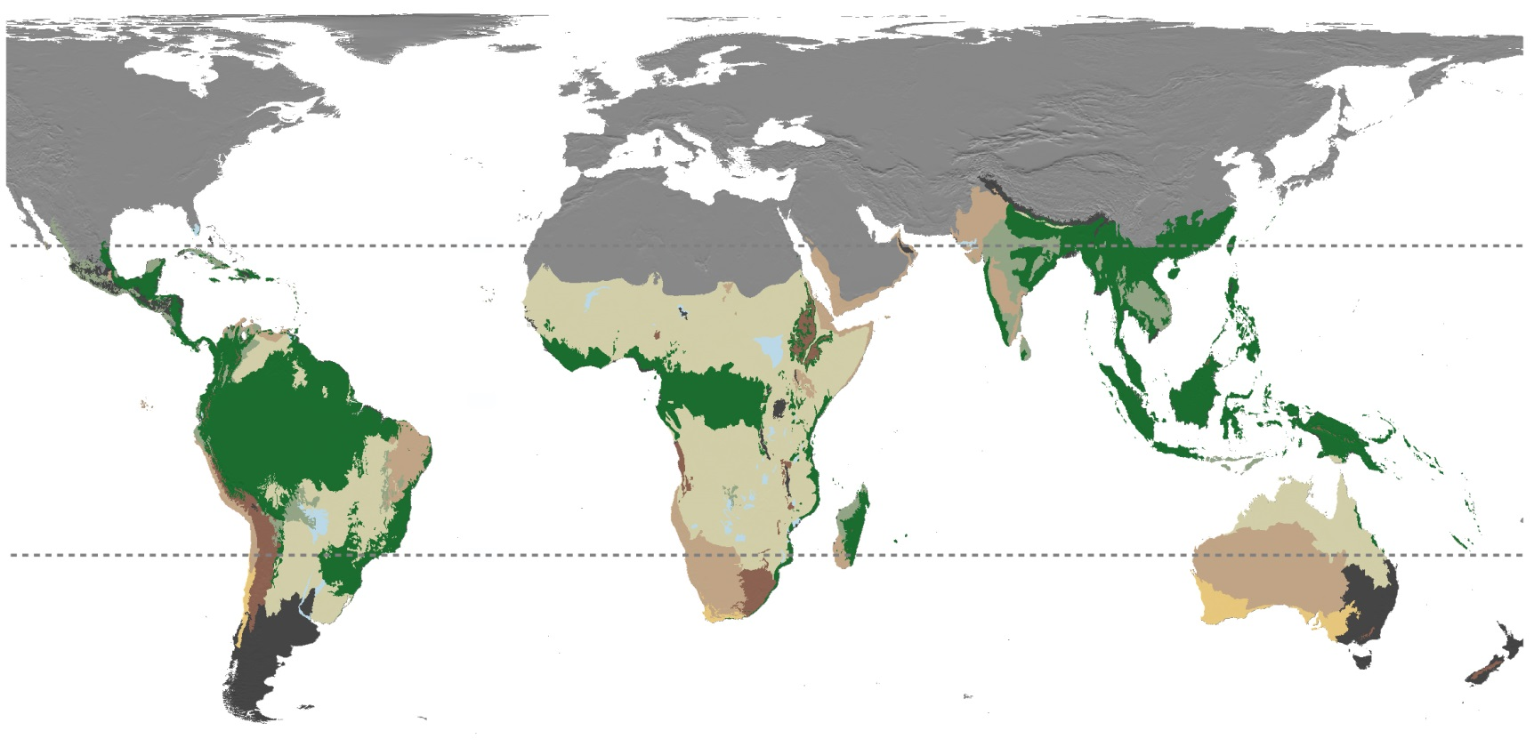
Time #1: Biome and bioregion connectivity through time
Species A
Species B
Bioregion shift
Species C

Slide 45
Time #1: Biome and bioregion connectivity through time
Antonelli*, Zizka*, Carvallho* et al. (2018), PNAS

Slide 46
Time #1: Biome and bioregion connectivity through time
4,450 species, 1,3 million occurrences, published phylogenies
Area assignment using SpeciesGeoCoder (Topel, Zizka, et al. 2017, Syst Biol)
Range shift estimated in BioGeoBEARS (Matzke et al. 2013 MEE)

Slide 47
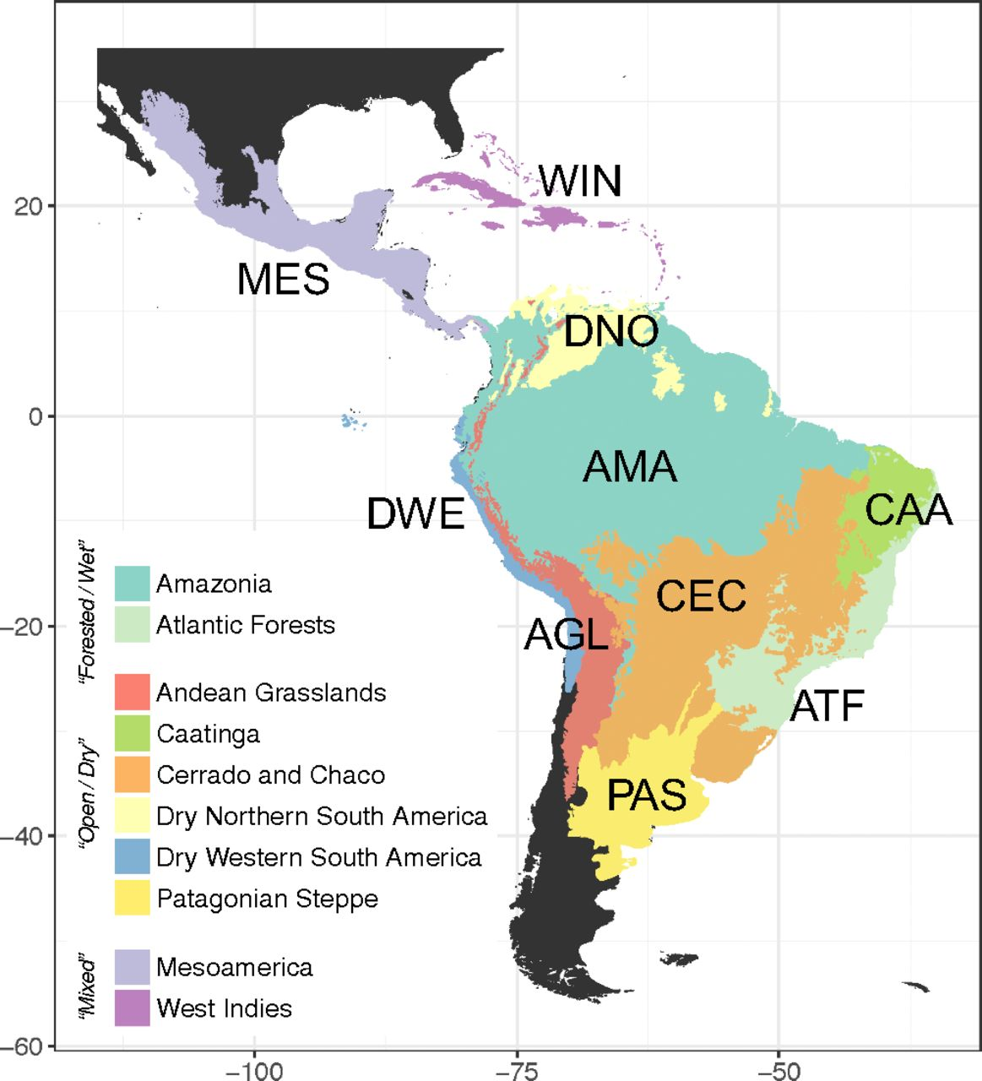
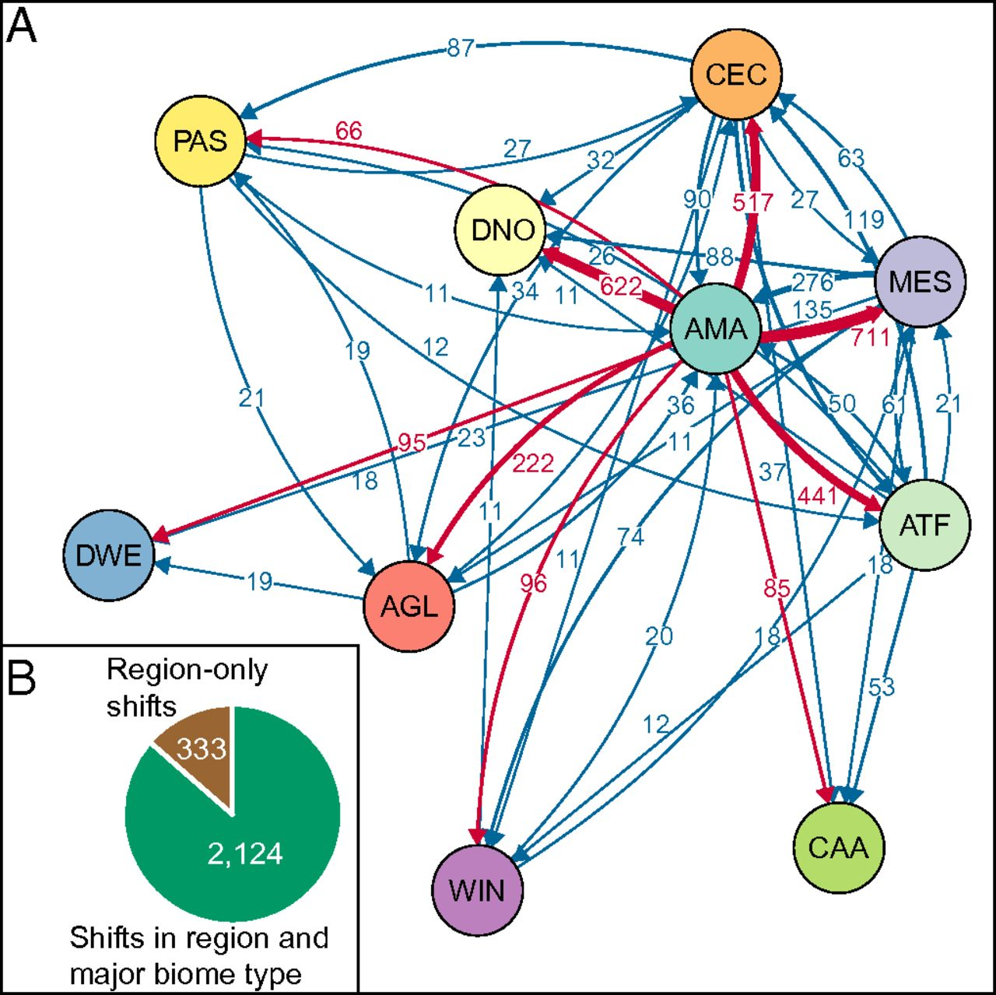
Time #1: Biome and bioregion connectivity through time
Substantial interchange
Amazonia is in the center
Antonelli*, Zizka*, Carvallho* et al. (2018), PNAS

Slide 48
Time #1: Biome and bioregion connectivity through time
Large similarities across taxonomic groups
Antonelli*, Zizka*, Carvallho* et al. (2018), PNAS

Slide 49
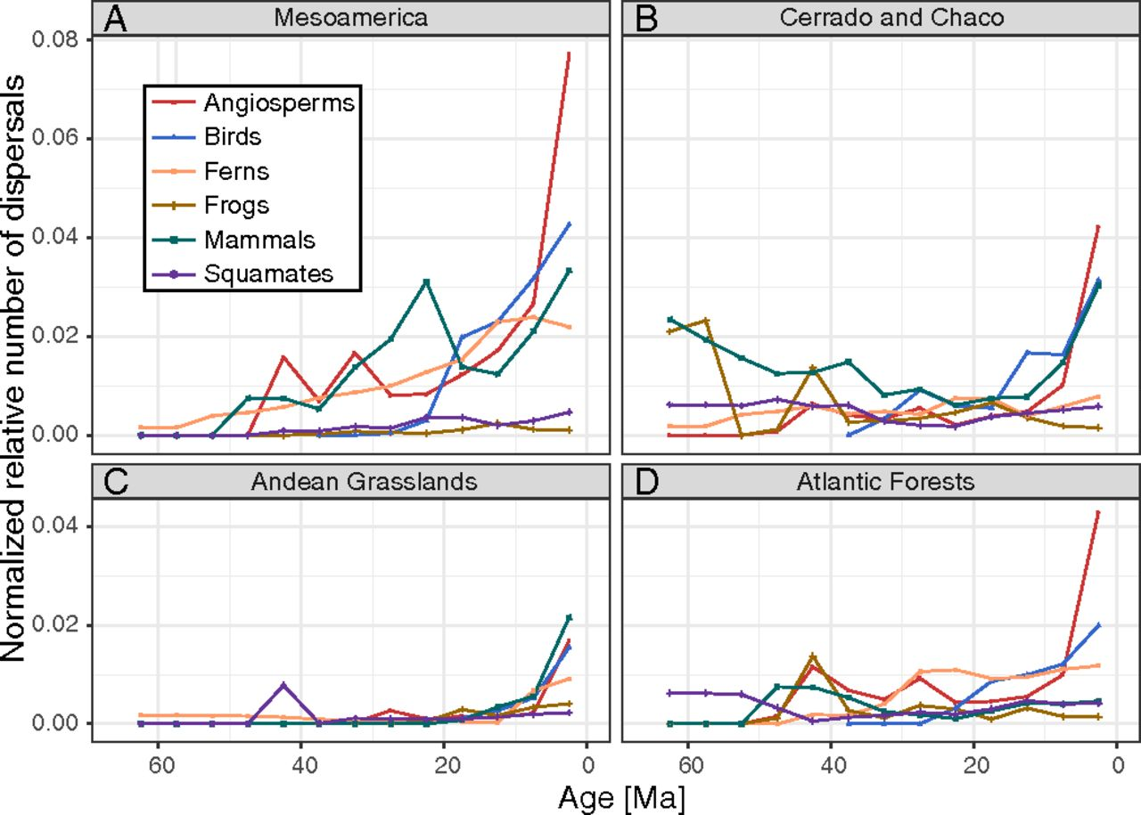
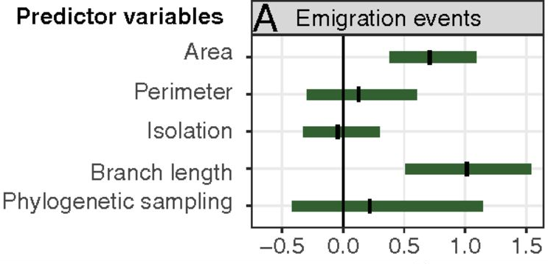
Time #1: Biome and bioregion connectivity through time
Tens of millions of years
Diversity & area best predictors
Antonelli*, Zizka*, Carvallho* et al. (2018), PNAS

Slide 50
Time #1: Biome and bioregion connectivity through time

Slide 51
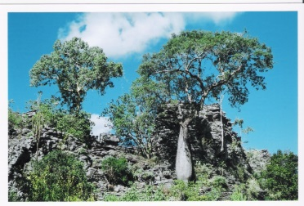
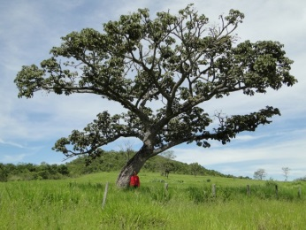
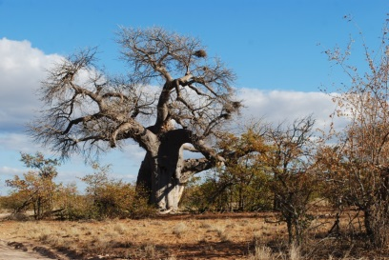
Time #1: Biome and bioregion connectivity through time
Bombacoideae
20,000 occurrence records, 104 species, 5 genes
Evergreen rainforest and seasonally dry biomes
Time constraint DEC model in BioGeoBEARS
www.blueplanetbiomes.org

Slide 52
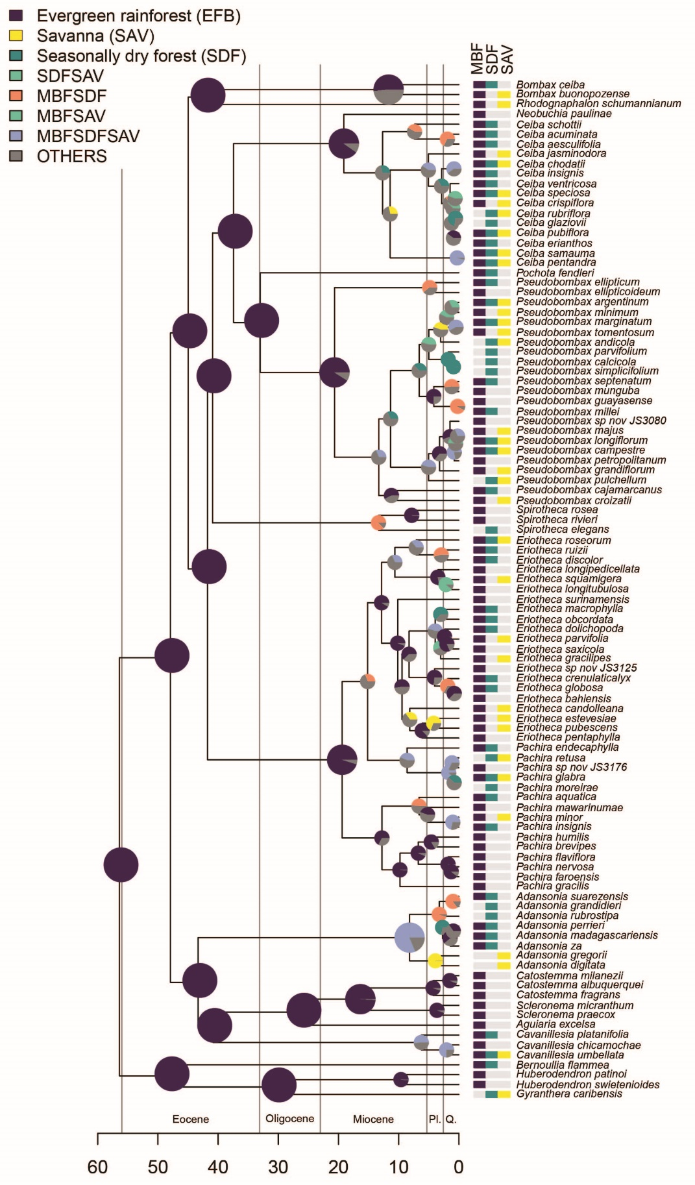

Time #1: Biome and bioregion connectivity through time
Many shifts among biomes
More from rainforest to dry biomes than vice versa

Slide 53

Time #1: Biome and bioregion connectivity through time
Constant shifts through the Miocene

Slide 54

Time ##:

Slide 55
Thank you!
http://alexanderzizka.net
https://github.com/azizka
@BiodivRsity

